Slide 1
Authentication of GNSS Orbital and Clock Parameters at Android Application Layer
P. Crosta, H. Serruys , G. Galluzzo, R. Lucas, T. Watterton
ION GNSS+, Miami, September 16-20, 2019

Slide 2

Outline
Galileo PVT: Architecture and Views
How we retrieve Satellite Ephemerids and Clock data
How we can authenticate GNSS Orbital and Clock parameters at Android application layer

Slide 3
Satellite and Map Views
Computation of up to 3 concurrent PVTs with GPS only, Galileo only and GPS + Galileo Weighted Least Square
Visualization on a Google map (hybrid or street view)
Configurable PVT (including GPS and Galileo dual frequency)
Inertial sensors Log
Download of Ephemeris and SV clock data from SUPL 2.0 server
Visualization Galileo satellites measurements
Prediction of satellite visibility and visualization of satellites on a sky plot

Slide 4
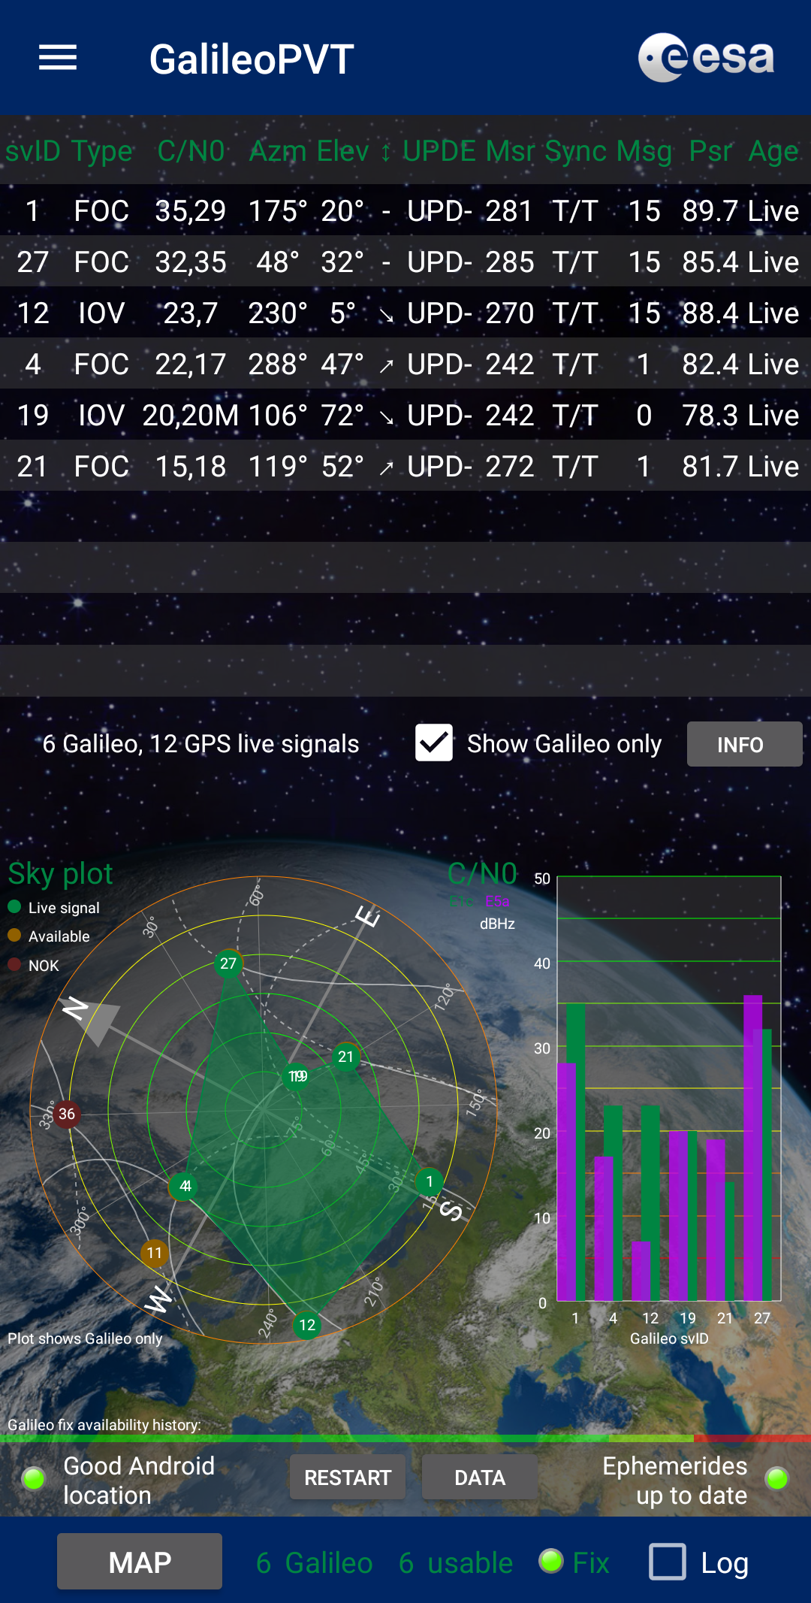
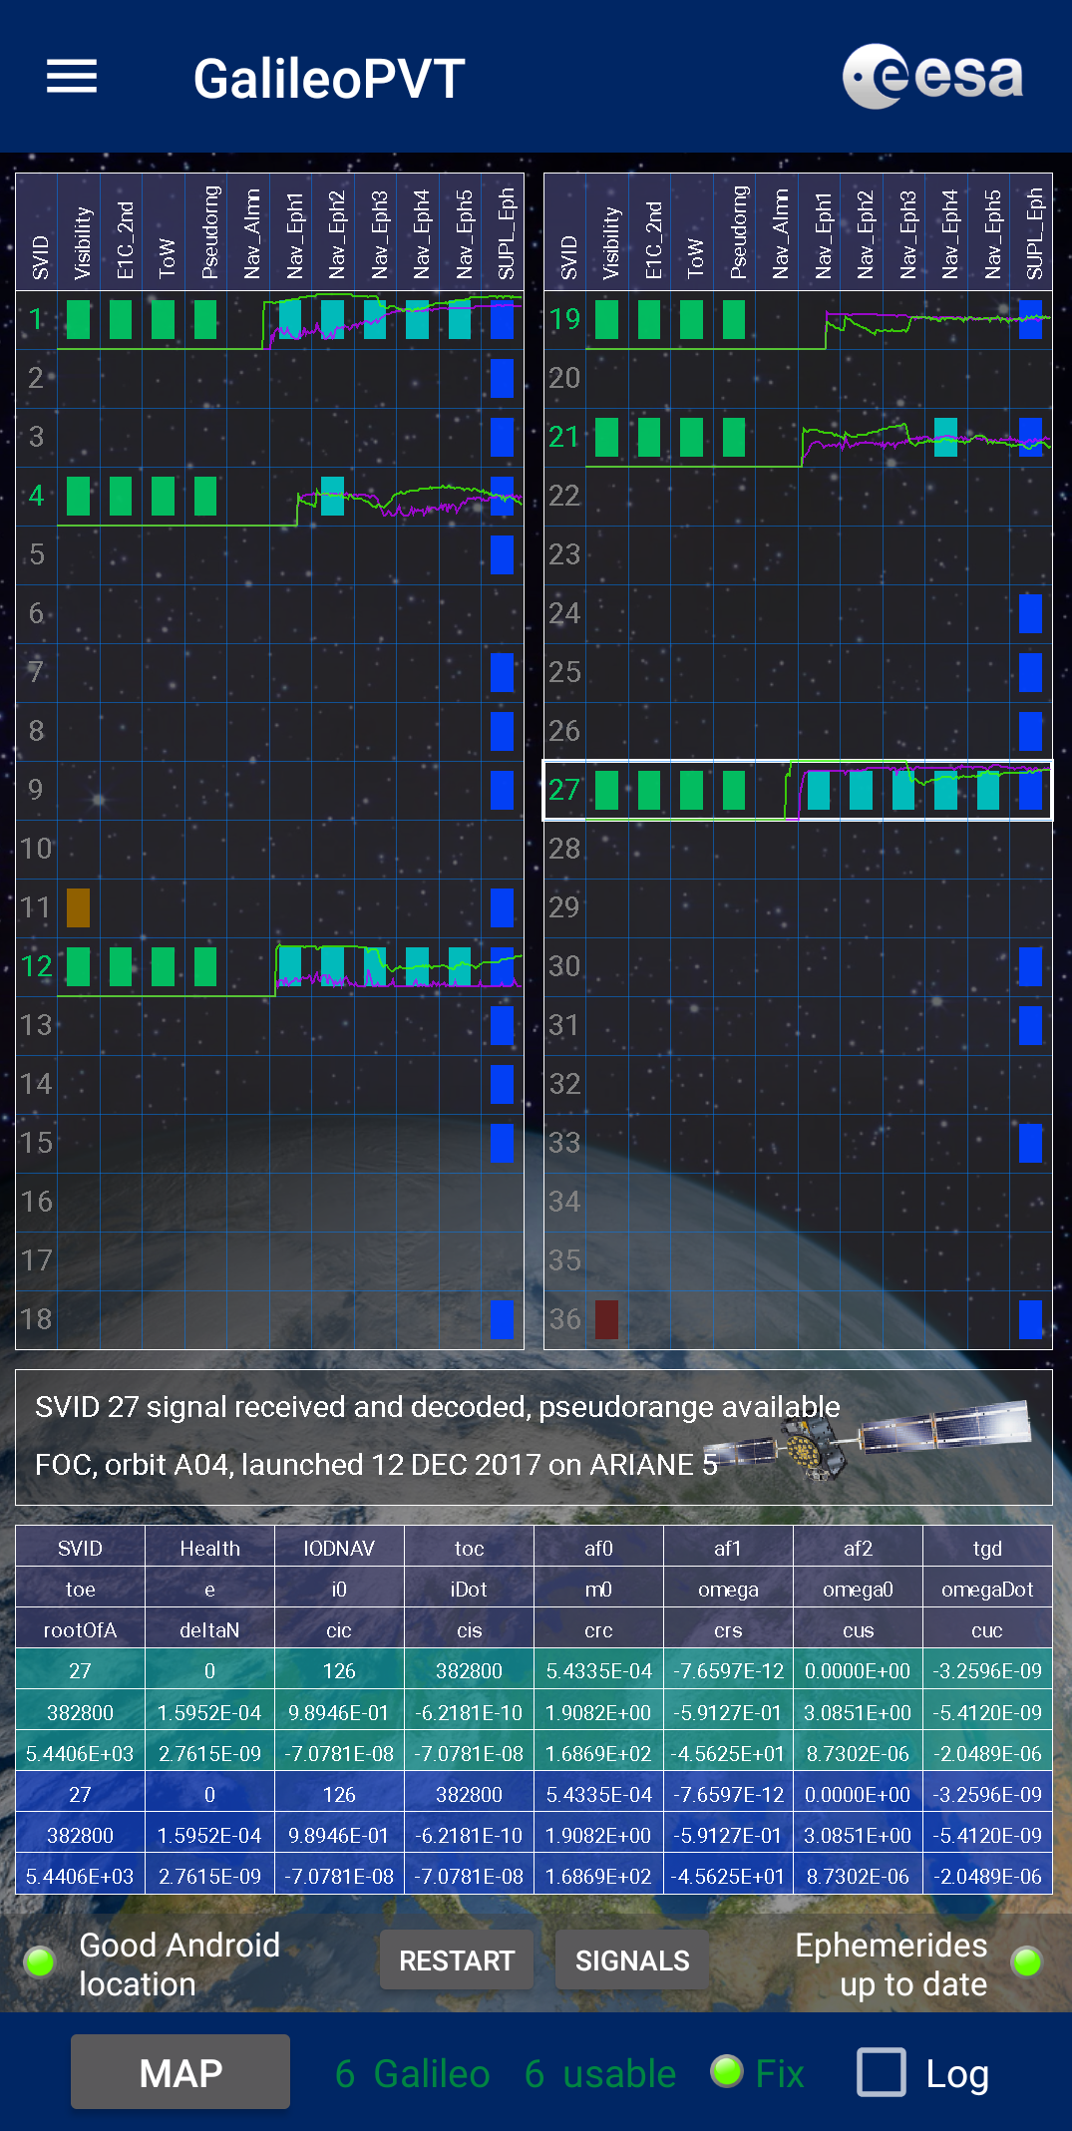
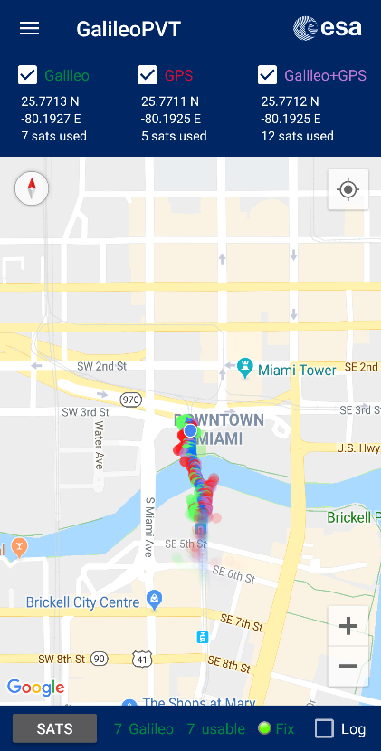
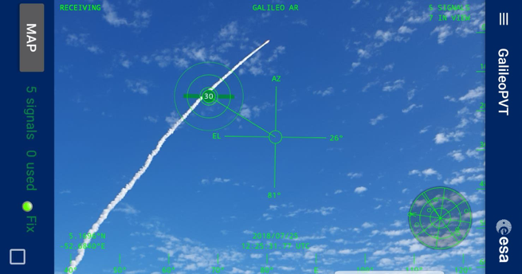
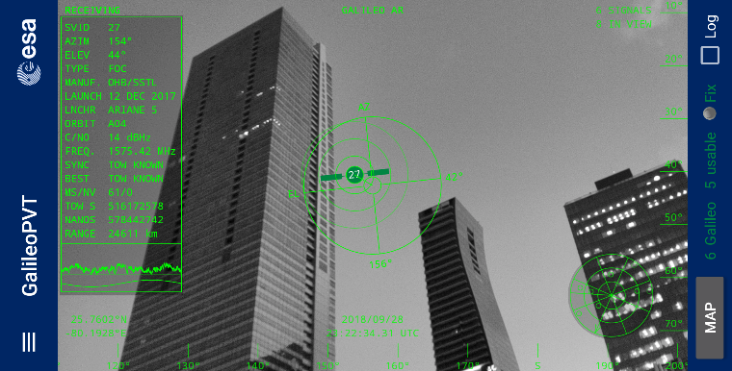
GalileoPVT by ESA

Slide 5
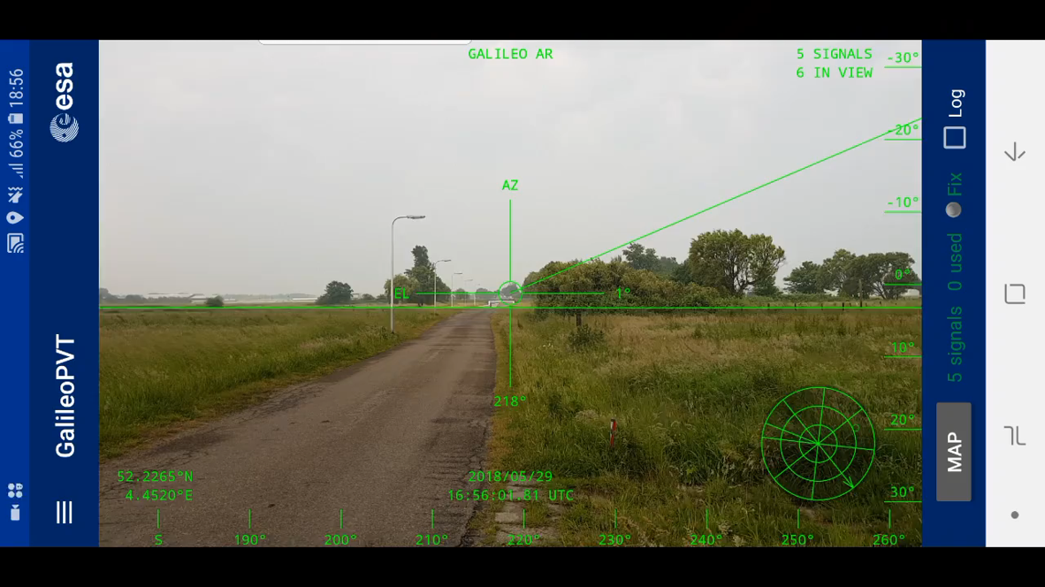
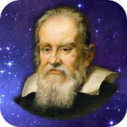


GalileoPVT - Augmented Reality View
Compatible with any phone with Android 7 (2500+ downloads)
GalileoPVT

Slide 6

Galileo PVT App – Architecture

Slide 7
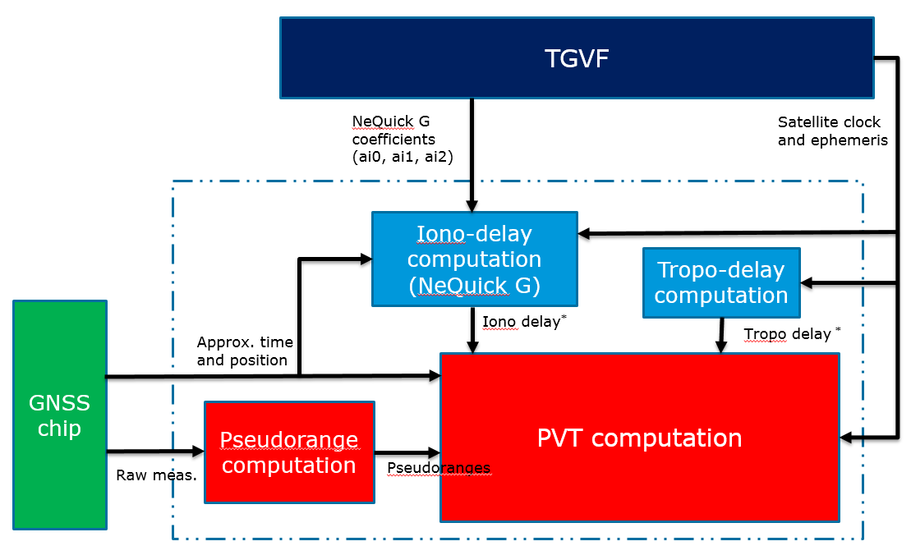
Main PVT Engine
SUPL 2.0 Google server

Slide 8
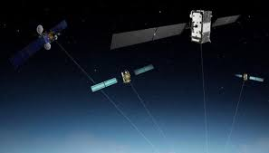
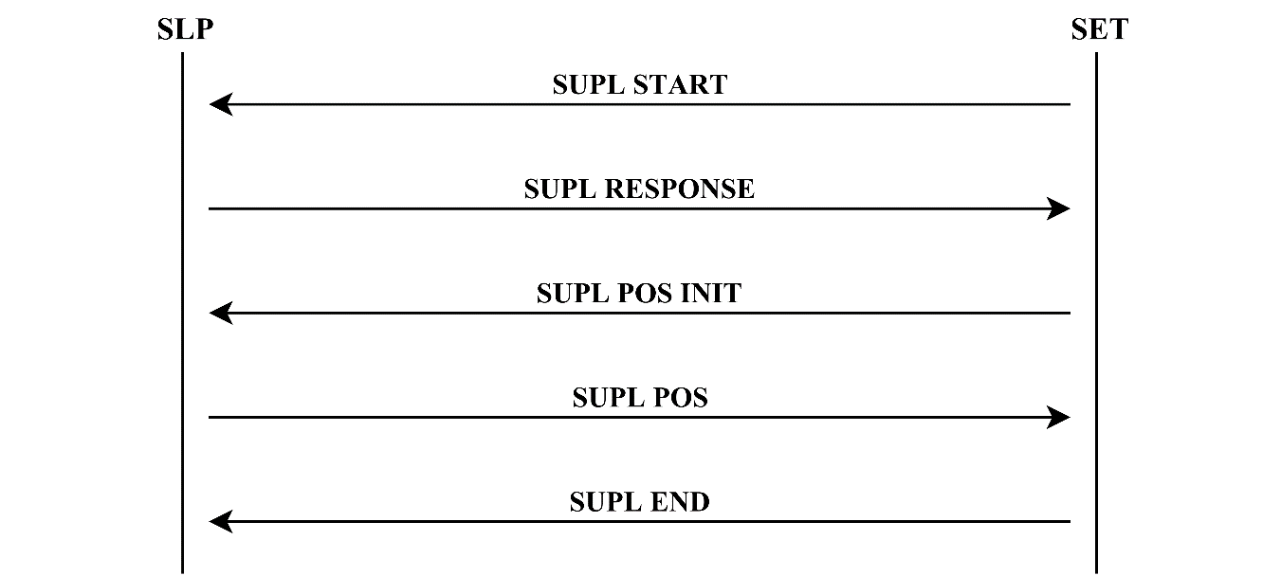



Retrieval of Satellite and Clock Orbits
SSL data connection
Broadcast ephemerids (near real-time)
Navigation message broadcast on L-Band
SLP – SUPL Location Platform (server)
Broadcast ephemerids (real-time)
Android GnssNavigationMessage Callback
NTRIP CASTER
(CNES, ESOC)
Broadcast real-time corrections for precise orbits and clock
http://www.ppp-wizard.net/caster.html

Slide 9
Getting SV Ephemeris and Clock
Different options have been evaluated: Real-Time provision needed!
Broadcast - #Nav message: the provision of the message depends on the tracking state and on the C/N0, it would reduce the number of satellites wchich can be used in PVT. Almost never available for Galileo on Samsung devices
SUPL 2.0 – AGNSS like. Server very reliable and long term maintained. Age of the ephemeris can reach up to 2 hours. Provision of the satellites ephemerids can be filtered based on the actual position and the expected visibility

Slide 10
Decoded messages
GPS SVID
Meas. State
C/No
2 | 0 | 16431 | 3.83E+14 | 15 | 35.62616
3 | 0 | 16431 | 3.83E+14 | 34 | 28.75746
6 | 0 | 16431 | 3.83E+14 | 8 | 40.84883
12 | 0 | 16431 | 3.83E+14 | 7 | 41.66902
14 | 0 | 16431 | 3.83E+14 | 12 | 37.40348
17 | 0 | 16431 | 3.83E+14 | 16 | 35.36886
19 | 0 | 16431 | 3.83E+14 | 6 | 43.3844
22 | 0 | 16 | 2.85E+11 | 1000000000 | 18.4544
24 | 0 | 16431 | 3.83E+14 | 6 | 45.21925
25 | 0 | 16431 | 3.83E+14 | 6 | 45.2508
29 | 0 | 16431 | 3.83E+14 | 16 | 34.98112
31 | 0 | 16 | 2.85E+11 | 1000000000 | 33.38265
32 | 0 | 16431 | 3.83E+14 | 6 | 44.50459
Nav | 877257197 | 2 | 257
Nav | 877257198 | 3 | 257
Nav | 877257200 | 6 | 257
Nav | 877257201 | 12 | 257
Nav | 877257203 | 14 | 257
Nav | 877257204 | 19 | 257
Nav | 877257204 | 24 | 257
Nav | 877257205 | 25 | 257
Nav | 877257206 | 29 | 257
Nav | 877257207 | 32 | 257
Mainly available only for GPS (in a Samsung Galaxy S8)
State 16 – no provision of the message
Low C/N0 (<28 dBHz) – data demodulation threshold

Slide 11
Navigation Message Content from the android API
Message | Type | Identifier | Sub Message Id | Data
Beidou D1 | 1281 | frame number in the range of 1-24 | subframe number of the navigation message, in the range of 1-5 | subframe data every 6 sec on 10 words of 30 bits: every word represented on 4 bytes (skip B31 and B32), with MSB first
Beidou D2 | 1282 | frame number, in the range of 1-120 | subframe number of the navigation message, in the range of 1-5 | subframe data every 0.6 sec on 10 words of 30 bits: every word represented on 4 bytes (skip B31 and B32), with MSB first
Galileo I/NAV | 1537 | nominal frame structure, this refers to the subframe number in the range of 1-24 | word type in the range 1-10+ | each page contains 2 page parts, even and odd, with a total of 2x114 = 228 bits, (sync & tail excluded) that should be fit into 29 bytes, with MSB first (skip B229-B232).
Galileo F/NAV | 1538 | nominal frame structure, this refers to the subframe number, in the range of 1-12 | page type in the range 1-6 | each word consists of 238-bit (sync & tail symbols excluded). Each word should be fit into 30-bytes, with MSB first (skip B239, B240), covering a time period of 10 seconds.
Glonass L1 | 769 | frame ID, in the range of 1-5 | String number, in the range from 1-15 | each string contains 85 data bits, including the checksum. These bits should be fit into 11 bytes, with MSB first (skip B86-B88), covering a time period of 2 seconds.
GPS CNAV-2 | 260
GPS L1C/A | 257 | For GPS L1 C/A subframe 4 and 5, this value corresponds to the 'frame id' of the navigation message, in the range of 1-25 (Subframe 1, 2, 3 does not contain a 'frame id' and this value can be set to -1.) | subframe number of the navigation message, in the range of 1-5 | subframe data every 6 sec on 10 words of 30 bits: every word represented on 4 bytes (skip B31 and B32), with MSB first
GPS L2-CNAV | 258
GPS L5-CNAV | 259

Slide 12
Examples of decoded messages from BCM-47755 Dual Frequency
Received messages: GPS L1CA(257), GLONASS L1 (769), Galileo I/NAV (1537)
The messages are provided every 6s for GPS L1C/A and 2s for Galileo and Glonass, i.e. at each sub-frame, page and string
Example for Galileo I/NAV data from BCM-47755
# Nav | Svid | Type
Nav | 7 | 1537 | 24 | 0 | -107 | 85 | 85 | 85 | 85 | 85 | 85 | 85 | 85 | 85 | 85 | 79 | 76 | -64 | -122 | -23 | -64 | 0 | 0 | 0 | 0 | 42 | -86 | -86 | 66 | 72 | 52 | 63 | 64
Nav | 7 | 1537 | 24 | 0 | -107 | 85 | 85 | 85 | 85 | 85 | 85 | 85 | 85 | 85 | 85 | 79 | 76 | -64 | -122 | -22 | 64 | 0 | 0 | 0 | 0 | 42 | -86 | -86 | 126 | 31 | -96 | -65 | 64
Nav | 7 | 1537 | 24 | 1 | 20 | -115 | 52 | 117 | 101 | -5 | 75 | 0 | 56 | -26 | -34 | -86 | 4 | -64 | -101 | 49 | -64 | 0 | 0 | 0 | 0 | 42 | -86 | -86 | 67 | -95 | -87 | -1 | 64
Nav | 7 | 1537 | 24 | 3 | 20 | -65 | -16 | 45 | -54 | 62 | 126 | -11 | -61 | 9 | -58 | -114 | -2 | -128 | -80 | -38 | -64 | 0 | 0 | 0 | 0 | 42 | -86 | -86 | 109 | -59 | -72 | 63 | 64
Nav | 7 | 1537 | 22 | 5 | 16 | -63 | 8 | 20 | 32 | 0 | -64 | 56 | 7 | -90 | 99 | 117 | -22 | -128 | -86 | -86 | -128 | 0 | 0 | 0 | 0 | 42 | -86 | -86 | 117 | -28 | -74 | 127 | 64
Nav | 7 | 1537 | 24 | 0 | -107 | 85 | 85 | 85 | 85 | 85 | 85 | 85 | 85 | 85 | 85 | 79 | 76 | -64 | -122 | -20 | 64 | 0 | 0 | 0 | 0 | 42 | -86 | -86 | 89 | 123 | -58 | -1 | 64
Nav | 7 | 1537 | 24 | 0 | -107 | 85 | 85 | 85 | 85 | 85 | 85 | 85 | 85 | 85 | 85 | 79 | 76 | -64 | -122 | -20 | -64 | 0 | 0 | 0 | 0 | 42 | -86 | -86 | 70 | 87 | -2 | 63 | 64
Nav | 7 | 1537 | 24 | 2 | 20 | -75 | 7 | 29 | 27 | -119 | -78 | -39 | 123 | -14 | -103 | 34 | -14 | -64 | -70 | -13 | 64 | 0 | 0 | 0 | 0 | 42 | -86 | -86 | 123 | 121 | 126 | -65 | 64
Nav | 7 | 1537 | 24 | 4 | 20 | -121 | 0 | 30 | 0 | 47 | 52 | -48 | 0 | 51 | -31 | 47 | -1 | -128 | -116 | 64 | 64 | 0 | 0 | 0 | 0 | 42 | -86 | -86 | 115 | 45 | 73 | 63 | 64
29 bytes per page

Slide 13
SUPL 2.0 extension to GANSS
The Google SUPL server "supl.google.com“ has been extended to the provision of assistance data for Galileo and Additional Navigation Satellite Systems (GANSS)
We have modified the Android SUPL client provided by Google (at https://github.com/google/supl-client) to retrieve Galileo Assistance data such as:
NeQuick Ionospheric model coefficients
Galileo satellites Clock and Ephemeris data
UTC model
The client works also for GPS and it can be extended easily to other GANSS such as Glonass and Beidou

Slide 14
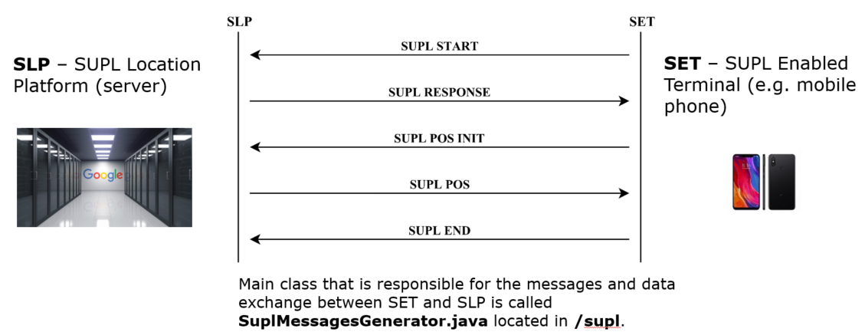
SUPL (Secure User Plane Location) server sending Assisted GNSS data with a SSL (Secure Sockets Layer) connection

Slide 15
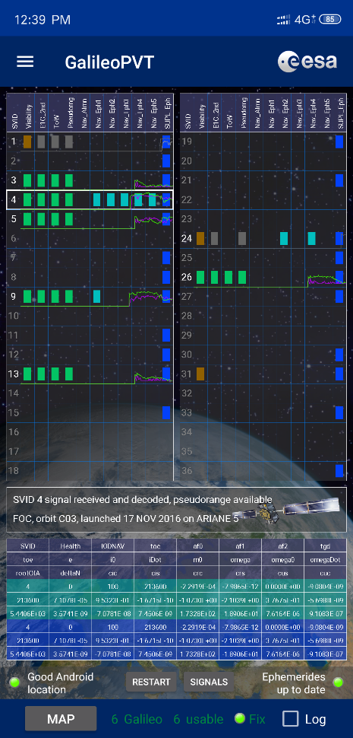
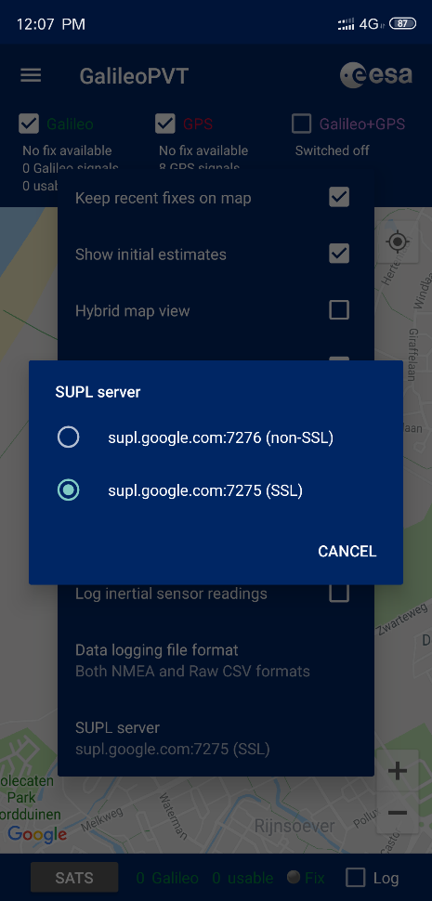
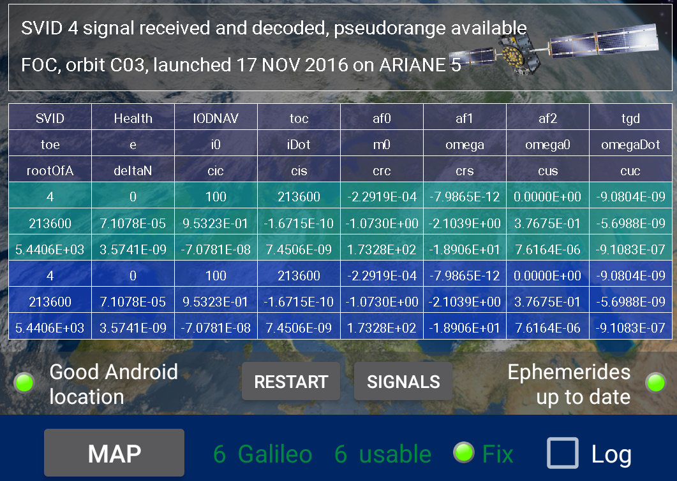
SUPL SSL server connection and Navigation Data view of the Galileo PVT app

Slide 16
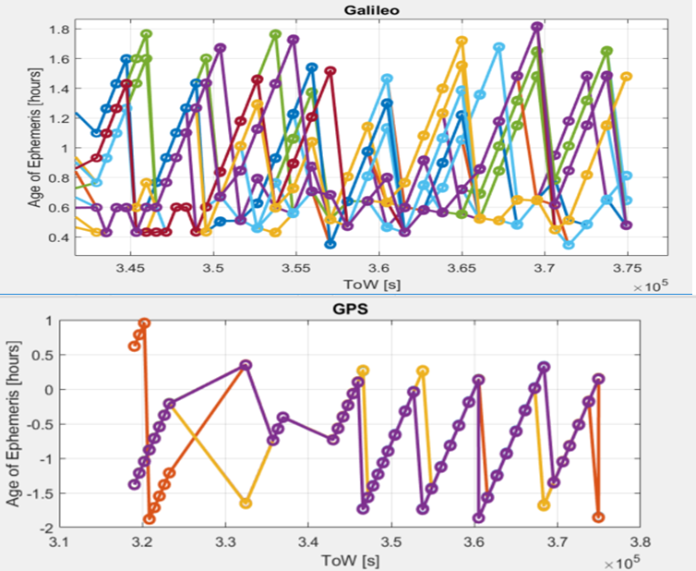
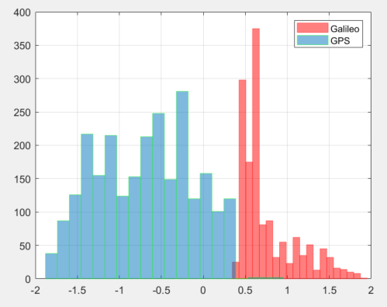
Age of Ephemerids retrieved from the Google server
Polling the google server every 10 minutes for 24 hours
Retrieved ephemerids for all the active Galileo satellites (also PRN14 and 18)
Minimum age around ½ hour and maximum around 2 hours well below the validity time of Galileo ephemerids

Slide 17
Dual source for satellite data
Trusted source either server with SSL or old batches of data (previously transmitted and preciously authenticated)
Uncertain: Live Broadcast satellite navigation message

Slide 18
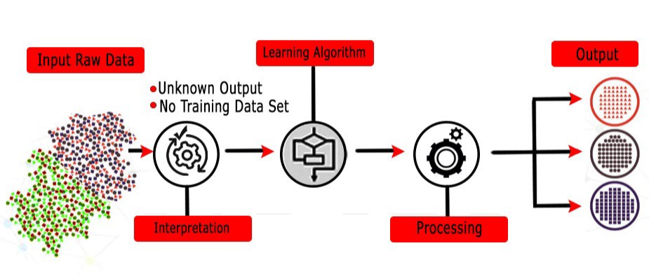
Authentication strategy
Bitwise comparison in case of same issue of data
Artificial intelligence in case of different issue of data based on unsupervised learning. Inputs:
dataset with database of broadcast ephemerids (no spoofing)
satellite position, vel. and clock bias estimated with different issue of

Slide 19
Learning ODTS a-posteriori fitting performance
The learning algorithm tries to :
find patterns per satellite in the ODTS fitting and its impact on the computation of satellites position and velocities.
Characterize the nominal performance and detect behaviors which are outside these boundaries (satellite anomaly or spoofing)
Correlations of multiple detections on multiple satellites in case of non-authentic reception of the navigation message

Slide 20
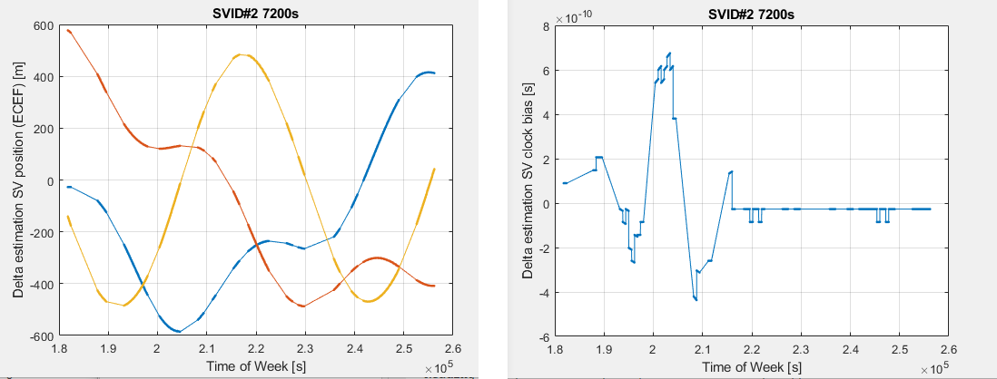
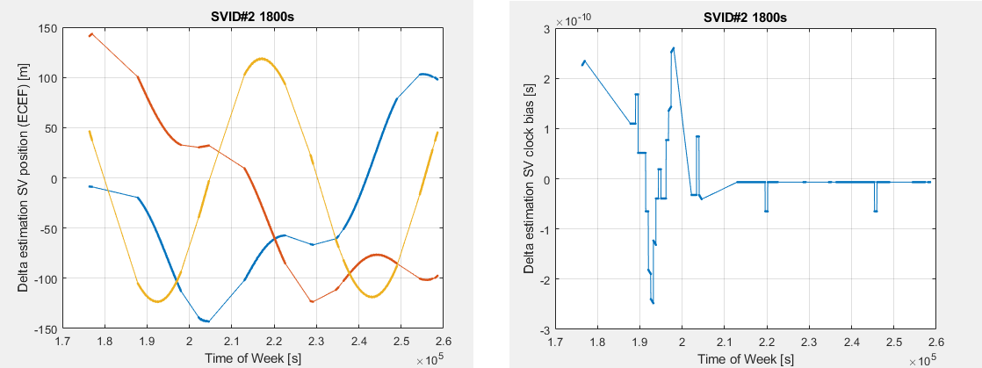
Dependency with age of trusted issue of data

Slide 21
Conclusions and further work

Slide 22

Thank you for your attention!
paolo.crosta@esa.int

